Slide 1
Optical Character Recognition and its Applications
Under the Guidance of
Ms. Shamama Anwar
Mohammad Ashhar Jawaid
Prakashdeep Singh Golan

Slide 2
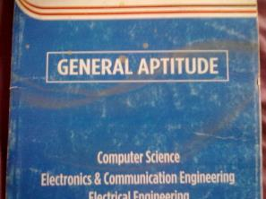
What is Text Extraction ??
Text Extraction is a process by which we convert Printed document/Scanned Page or Image in which text are available to ASCII Character that a Computer can Recognize.
GENERAL APTITUDE
Computer Science
Electronics & Communication Engineering

Slide 3
Contents
Aim & Objective, Problem Statement and Motivation
1
2
Approach
3
Preprocessing
4
Segmentation
5
Recognition

Slide 4
Aim and objective
Objectives
Recognition -
Recognize each of the character in the detected text region using a suitable algorithm
Segmentation -
Separate the text region into its individual characters.
The aim of this project is to detect, extract and recognize text from images, particularly license car plate.

Slide 5
Motivation
Text detection and recognition in general have quite a lot of relevant application for automatic indexing or information retrieval such document indexing, content-based image retrieval, and license car plate recognition which further opens up the possibility for more improved and advanced systems.

Slide 6
Problem statement
To segment the image to individual characters, we need to find the characteristic to be used as boundary to segment the image.
To classify, we need to use the best template to compare with the segmented image and to determine how the template will be used to compare with the image.

Slide 7
Approach - How will we achieve our Desired Goal?
1
2
3
Pre
processing
Segmentation
Recognition

Slide 8
Make template
To create template to be use for classification:
…
…
Matrix size 24 X 42 X 62
Saved as template
Atleast 62 images of characters (alphabets + numbers) Size = 42 X 24

Slide 9
Preprocessing
1
2
3
Initial Color Image
Gray Scale
Binarize & Invert

Slide 10
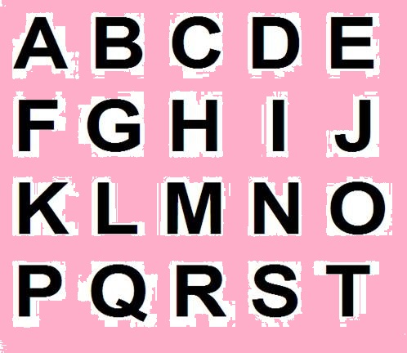
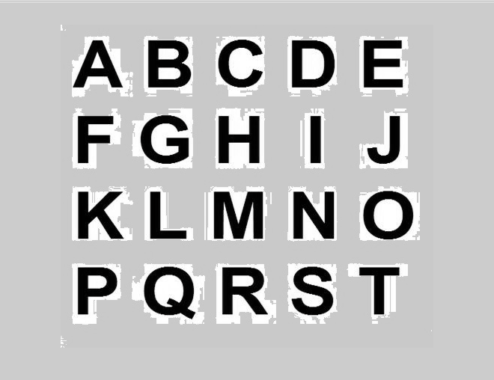
Gray Scale
The first step in pre-processing the image is to convert the input image into grayscale so that it can be easily converted to a binary image for further processing.

Slide 11
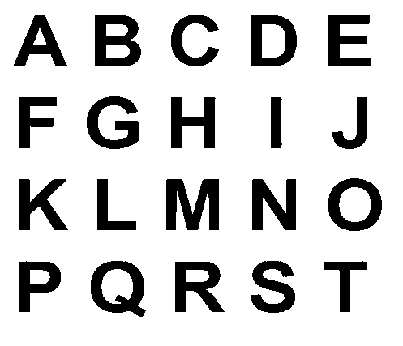
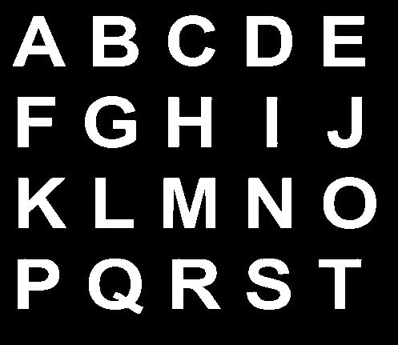
Binarization and Inversion

Slide 12
Segmentation
1
2
Line Extraction
Character Extraction

Slide 13




Segmentation – Line Extraction
Preprocessed Binary Image
Segmented Image

Slide 14
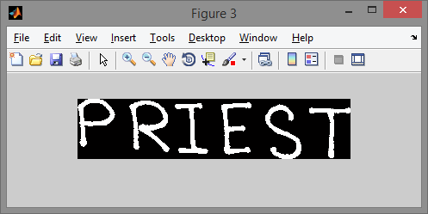
Segmentation – Connected Components
The segmentation character involves the following steps:
Scan the image from left to right to find ‘on’ pixel.
If on pixel been found, all ‘on’ pixel connected to the detected on pixel will be extracted segmented as a pixel.
The process will be repeated until it reach end right of the image.

Slide 15

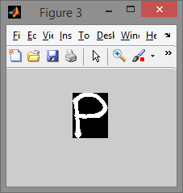
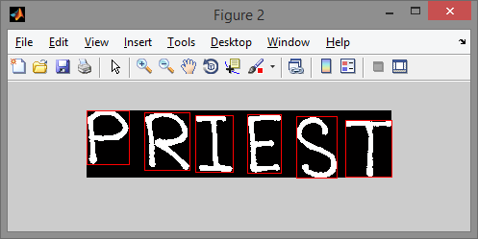
Segmentation – Character Extraction

Slide 16
Recognization
1
2
Character Recognition
Text Document

Slide 17
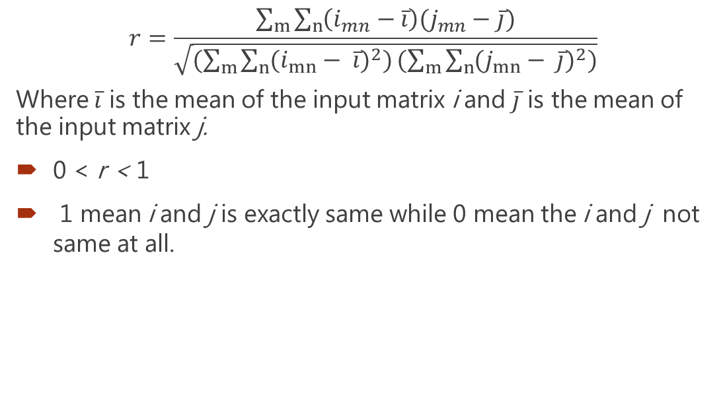
Corr2
$$r=\frac{\sum_{m}{\sum_{n}{\left(i_{mn}−\overline{i}\right)(j_{mn}−\overline{j})}}}{\sqrt{(\sum_{m}{\sum_{n}{{(i_{mn}− \overline{i})}^{2})}}(\sum_{m}{\sum_{n}{{(j_{mn}− \overline{j})}^{2})}}}}$$
Where $\overline{i}$ is the mean of the input matrix i and $\overline{j}$ is the mean of the input matrix j.
0 < r < 1
1 mean i and j is exactly same while 0 mean the i and j not same at all.

Slide 18


Recognition - Template Correlations
temp = templates(:,:,j);
in = chars(:,:,i);
allCorrs(j) = corr2(temp, in);
Source | Image | Template
image
allcorrs(j) |  | 0.82011 | 0.57395 | 0.43850

Slide 19
The entire procedure
Template with size 42 X 24 was created using images of 62 characters.
To conduct the experiment, all images have been renamed as their ground truth and saved in a folder.
A Matlab script as included in appendices was created to load all the images in the folder as well as their name and then perform preprocess segmentation and recognition to all of the images.
Then the result of the segmentation and recognition were done. The result will also be analyzed automatically by the Matlab script.

Slide 20
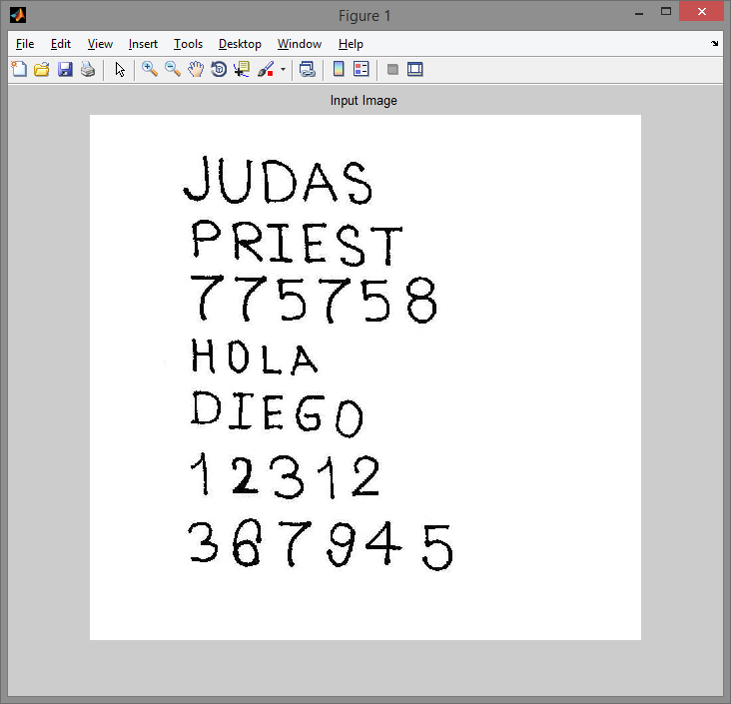
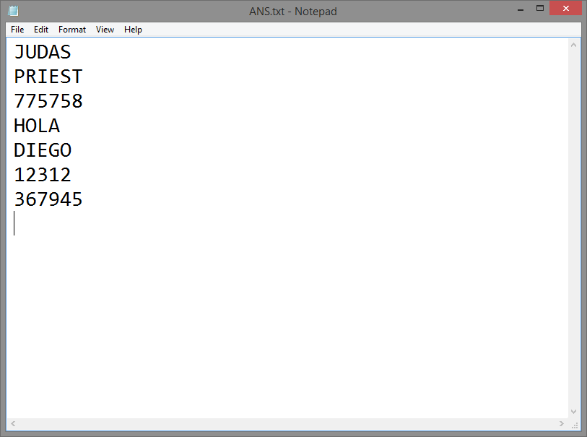
Result
After the entire procedure was carried out, we got our result as a text file which contained the text present in the image

Slide 21

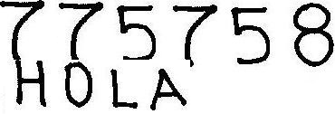

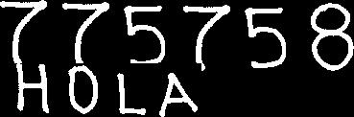
Cases of Failure
Image that failed to be segmented using connected components
 | Image
Original image
Segmented image

Slide 22
Applications
Banking (To read Credit Card)
Libraries (Convert Scanned Page to Text)
Govt. Sector (Form Processing)
Used in Car Number Plate Recognition System
Help visually impaired people by converting image to text and then to speech

Slide 23

Text To Speech Conversion
Text to Speech (TTS) refers to the ability of computers to read text aloud. A TTS Engine converts written text to a phonemic representation, then converts the phonemic representation to waveforms that can be output as sound. TTS engines with different languages, dialects and specialized vocabularies are available through third-party publishers.

Slide 24
Text to Speech
The Text to Speech (TTS) procedure which we are using was created on .NET framework by Microsoft (SAPI).
System requirements include having .NET installed.
TTS uses Microsoft’s Synthesiser Class (which basically comes with every Windows System starting from Windows XP)
Microsoft’s SpeechSynthesiser Class is used for speech conversion.
Microsoft’s TTS Namespace is the TTS Engine.

Slide 25
Code snippet for TTS
if nargin<1
text = 'Please call this function with text';
end
try
NET.addAssembly('System.Speech');
Speaker = System.Speech.Synthesis.SpeechSynthesizer;
if ~isa(text,'cell')
text = {text};
end
for k=1:length(text)
Speaker.Speak (text{k});
end
catch
warning(['If this is not a Windows system or ' ...
'the .Net class does not exists you will not be able to use this function.' ']);
end

Slide 26
Automatic Number Plate Recognition
Automatic number plate recognition (ANPR) is a mass surveillance method that uses optical character recognition (OCR) on images to read vehicle registration plates. They can use existing closed-circuit television or road-rule enforcement cameras, or ones specifically designed for the task. They are used by various police forces and as a method of electronic toll collection on pay-per-use roads and cataloguing the movements of traffic or individuals.

Slide 27
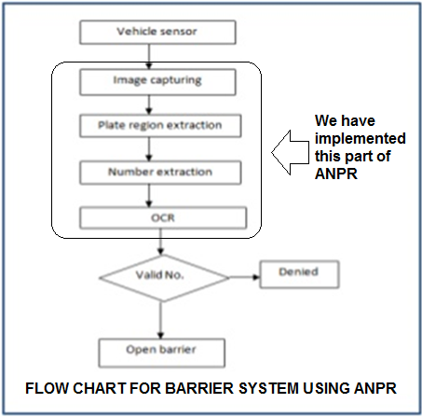
Automatic Number Plate Recognition

Slide 28
Automatic Number Plate Recognition
The whole system is divided into the following steps:
1. Plate location or finding location of plate in the vehicle image and cropping plate image from it.
2. Plate segmentation or cutting plate image to character’s images.
3. Character recognition or convert character’s images to final distinguished characters among them.
4. Syntactical/Geometrical analysis – check characters and positions against country-specific rules.

Slide 29
Approach - How will we achieve our Desired Goal?
1
2
3
Pre
processing
License Plate Extraction
Segmentation and Recognition

Slide 30
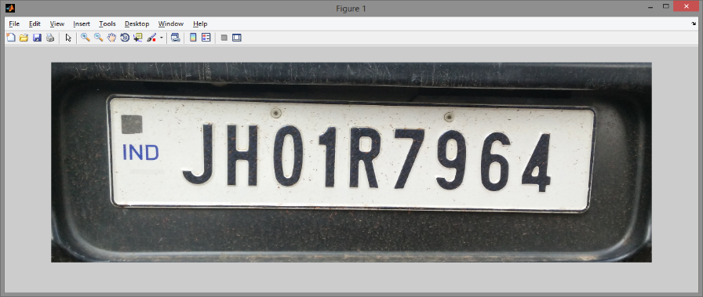
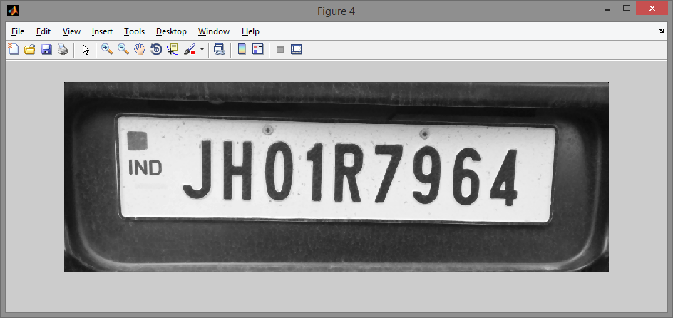
Pre-Processing
Converts a multi-colored image into a binary image.
Grey Conversion
We have taken colour image of car clearly showing its License plate for experiment. We firstly convert this RGB colour input image to a 256 grayscale image
Median Filtering
It is inevitable for containing noises of original image. We use median filtering to eliminate the noises. Using median filtering not only can eliminate the noises, but also make the high frequency more concentrated.

Slide 31
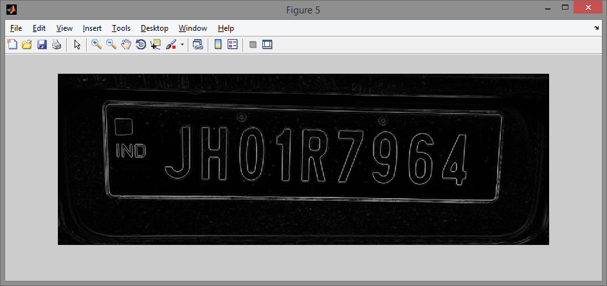
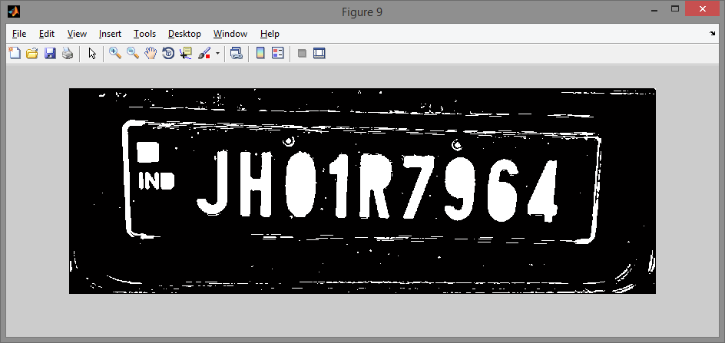
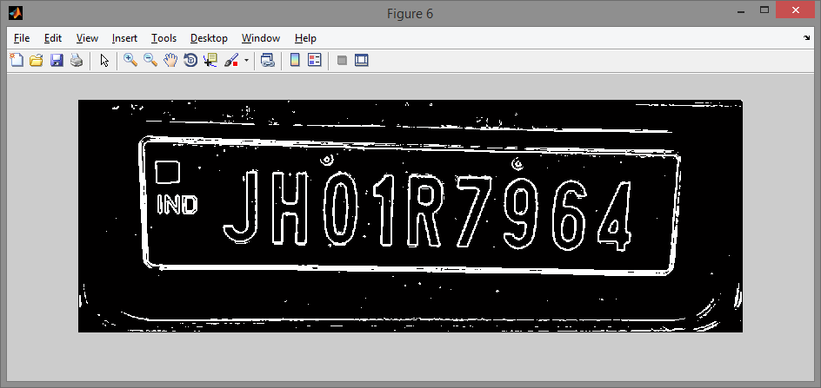
LICENSE PLATE EXTRACTION
From the grayscale image, the area of interest (i.e. the number plate) is extracted and scanned for text recognition.

Slide 32
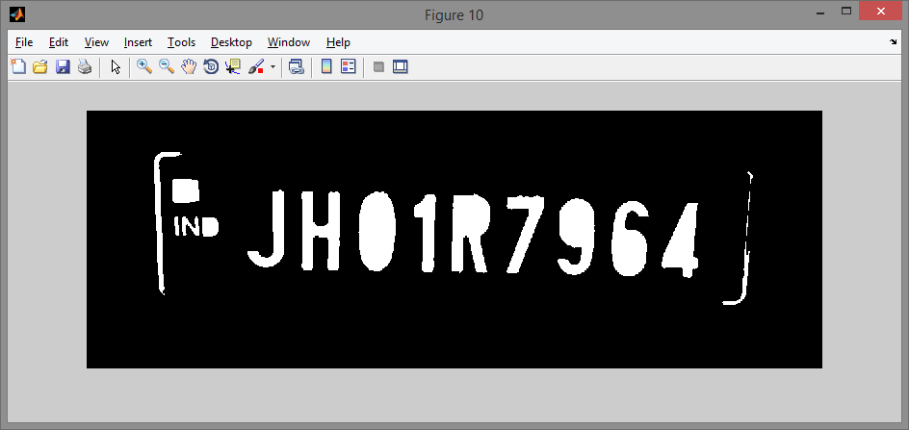
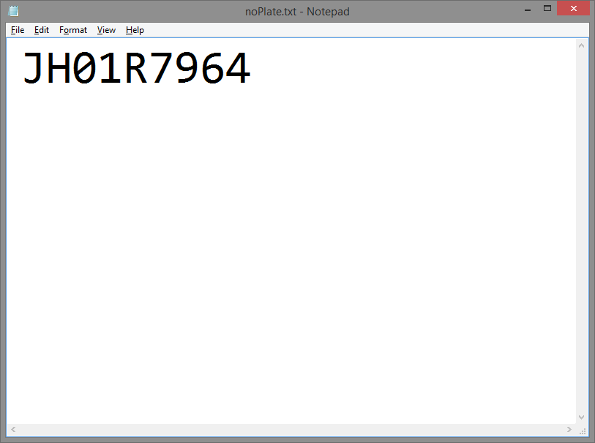
CHARACTER SEGMENTATION AND RECOGNITION
The number plate extracted is now run under the ocr algorithm to output the number plate text in a text document.

Slide 33
Conclusion
The objective of this paper is to segment and recognize characters in image have been achieved. Even though the segmentation accuracy from the experiment is very high, the result during real application may be lower due to limited set of picture used in experiment. However, this is shown that segmentation using connected components is best method to segmenting the image.
After several experiments been done to find the best method to recognize the characters with highest accuracy and considerable amount of time, the best way is by using templates correlations as main recognition method.

Slide 34
References
Kurt Alfred Kluever. (2008) Digital Media Library : RIT Scholars. [Online]. https://ritdml.rit.edu/bitstream/handle/1850/7813/KKlueverTechPaper05-20-2008.pdf
C. H. Ho, S. B. Koay, M. H. Lee, M. Moghavvemi, and M. Tamjis, "License Plate Recognition (Software)," Universiti Malaya.
Sheroz Khan, Rafiqul Islam Othman khalifa, "Malaysian Vehicle License Plate Recognition," The International Arab Journal of Information Technology , pp. 359-364, 2007.
Edge Based Text Extraction From Complex Images by Xiaoqing Liu and Jagath Samarbandhu.
Character Recognition IEEE paper from KATHEY, University of Berkley.
Automatic Text Detection using Morphological Operations and Inpainting by Khyati Vaghela.

Slide 35
References
Font and Background Color Independent Text Binarization by T.Kasar , J.Kumar , A.G. Ramkrishnan.
OCR for Devnagari Script by Mahesh Goyani.
Sheroz Khan, Rafiqul Islam Othman khalifa, "Malaysian Vehicle License Plate Recognition," The International Arab Journal of Information Technology , pp. 359-364, 2007.
MATLAB Documentation
http://cnx.org/content/m12531/latest/#
http://lab.fs.uni-lj.si/lasin/wp/IMIT_files/neural/doc/seminar5.pdf

Slide 36
Thank You

